Slide 1
Amsterdam AirBnB

Slide 2
Amsterdam AirBnB
How do we determine a worthwhile investment?
We want a steady stream of income.
We want customers to regularly visit our hotel.
The hotel must have a good reputation.
Is it in a good location?
Are there any low hanging fruits?

Slide 3
Let’s try to emulate success from other hosts.
How can we determine if a host is successful?
Price?
Number of reviews?
Location?
Ratings?

Slide 4
Assumptions Made
How can we determine if a host is successful?
Assume that successful host = high review count, high ratings

Slide 5
Definition of success

Slide 6
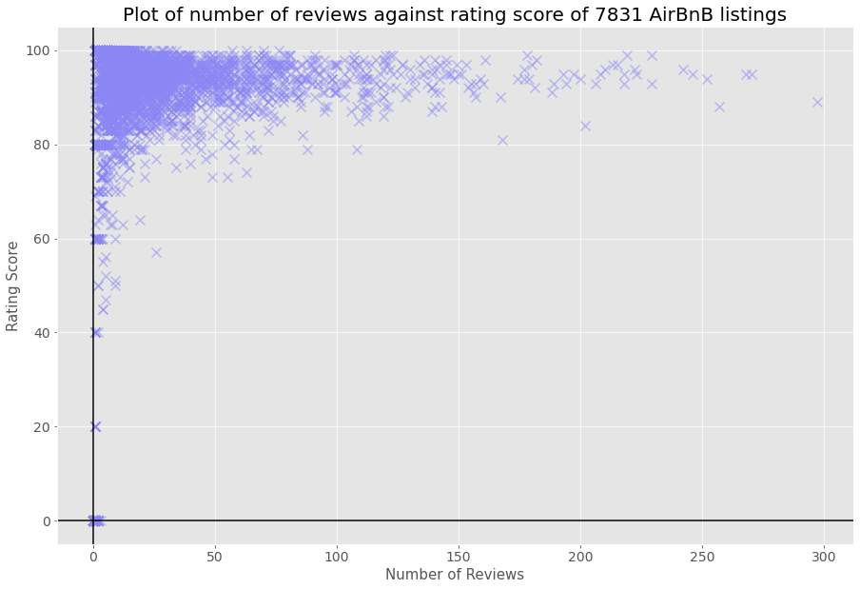
Number of reviews vs rating score

Slide 7
Assumptions Made
Let’s filter the chart and see only the top 25% of hosts.
Criteria: Above 98% rating and above 15 reviews

Slide 8
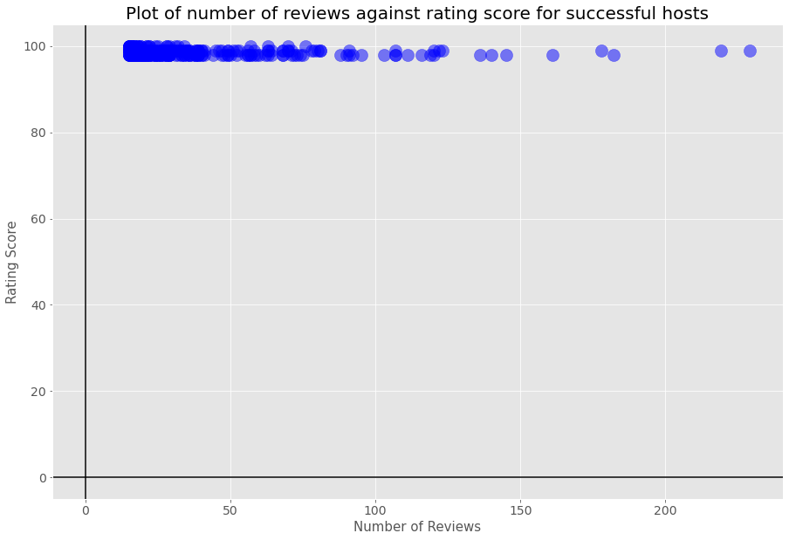
Successful Host Chart

Slide 9
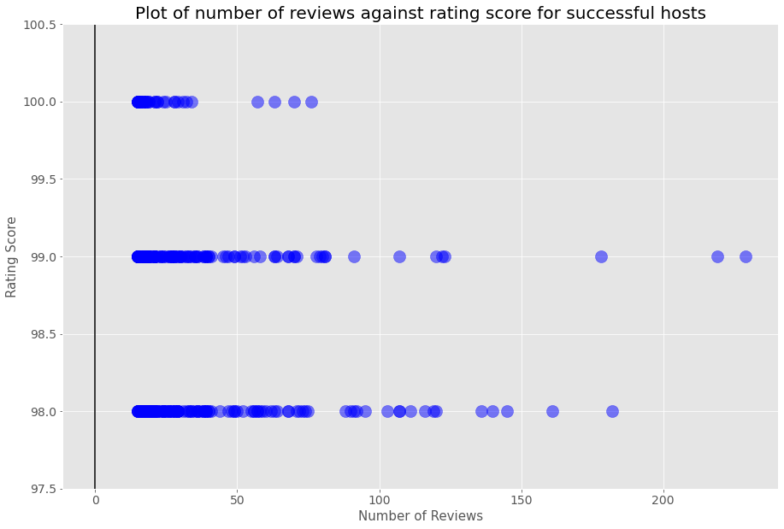
Zoomed In

Slide 10
Median price of successful hosts

Slide 11
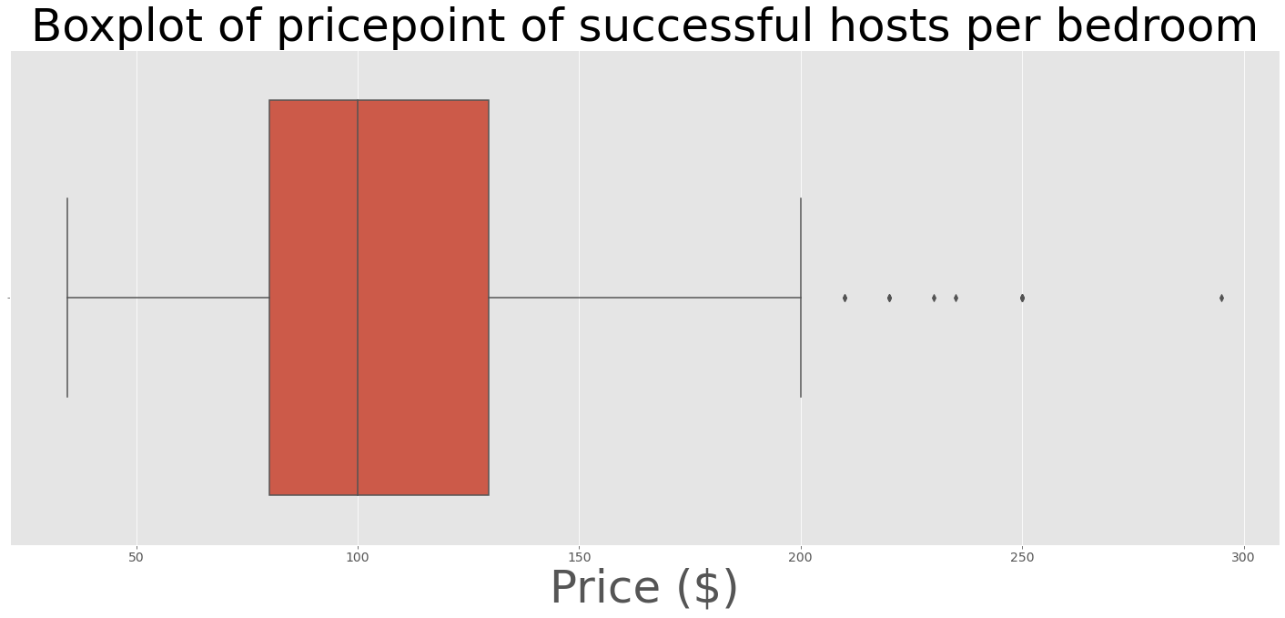
Distribution of price Median = $100 per day

Slide 12
Improving the profitability
Can we do better than this?
Let’s take a look at which types of properties are successful and which neighbourhoods are more likely to succeed.

Slide 13
Deep dive into property types

Slide 14
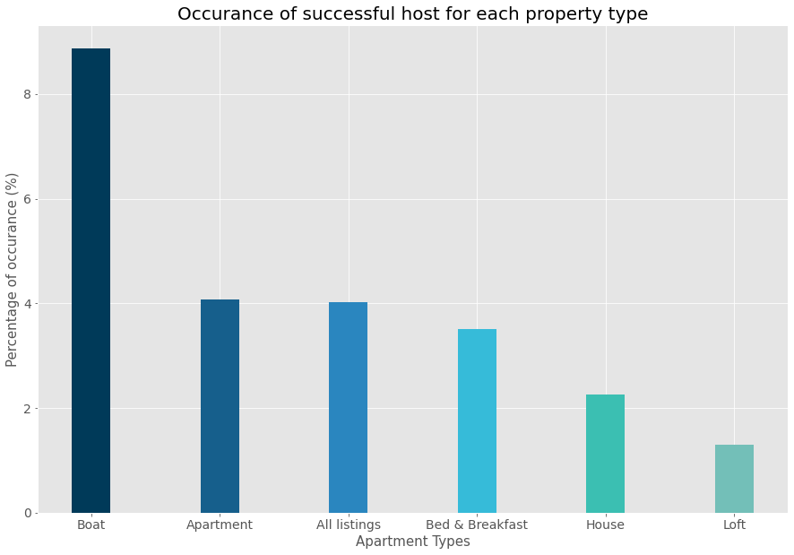
Improving the profitability

Slide 15
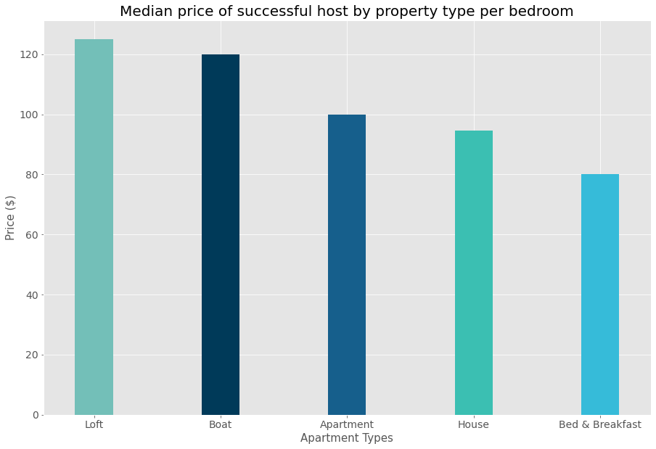
Improving the profitability

Slide 16
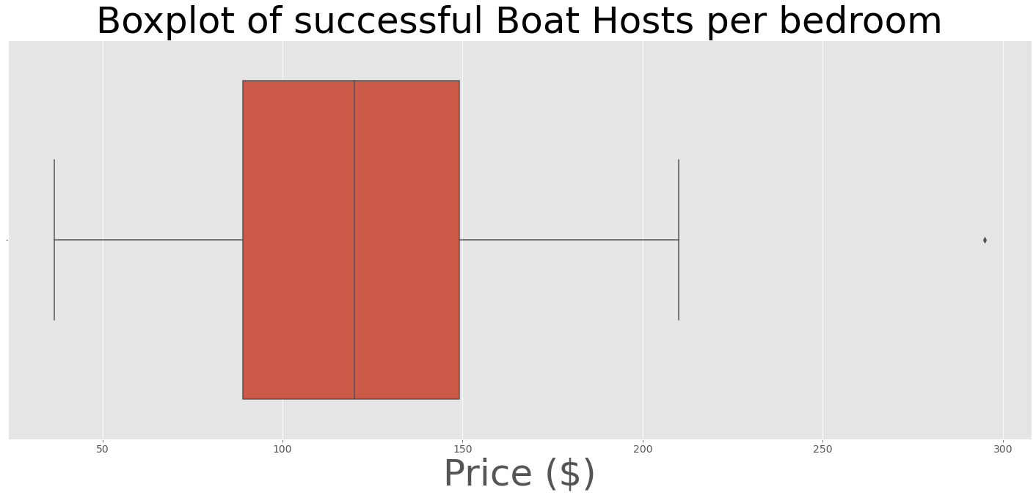
Median price of successful Boat Hosts = $120

Slide 17
Focusing on the neighborhoods

Slide 18
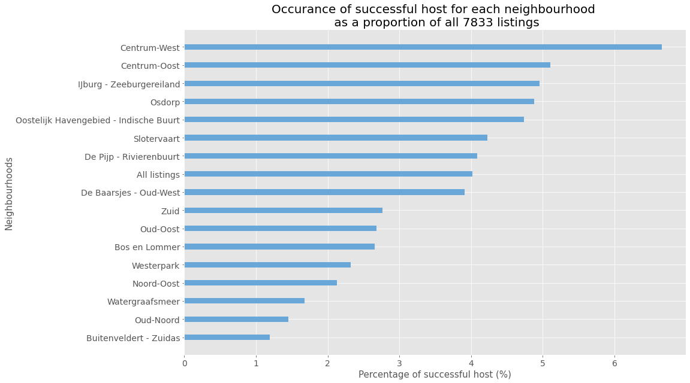
Which Neighborhood contributes more to success?

Slide 19
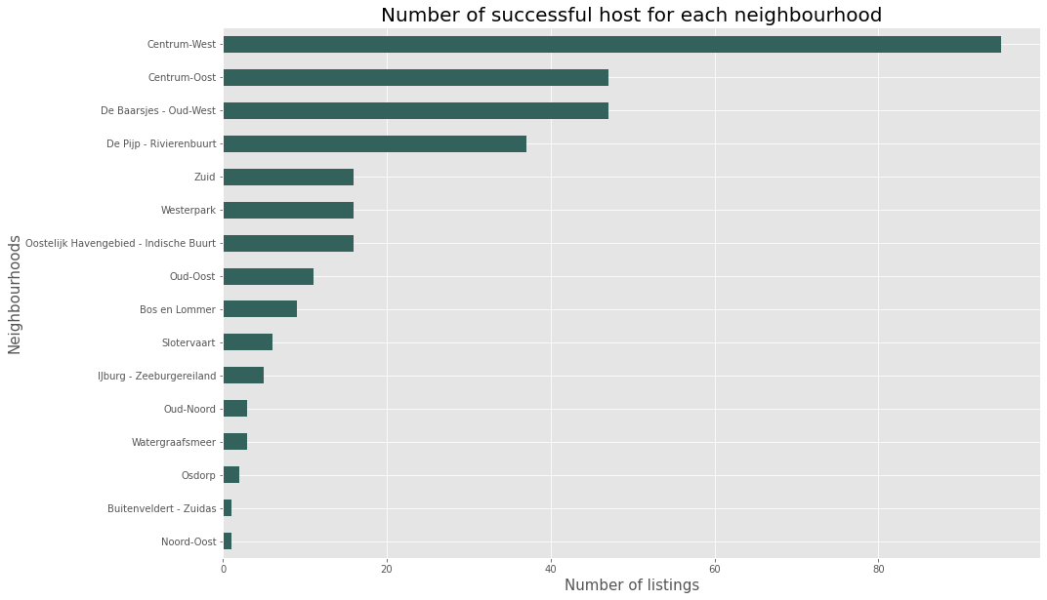
Which Neighborhood has more successful hosts

Slide 20
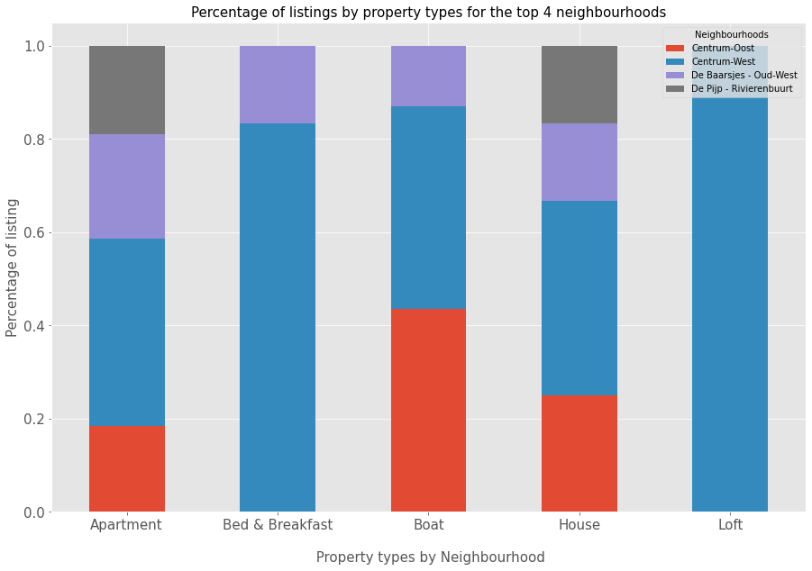
Normalized distribution of property type by neighborhood

Slide 21
How long will it take for me to be successful?
Is there a timeframe that we’re looking at?
Perhaps we can take a look at the distribution of how long the AirBnB hosts have been around.

Slide 22
Timeframe for success

Slide 23
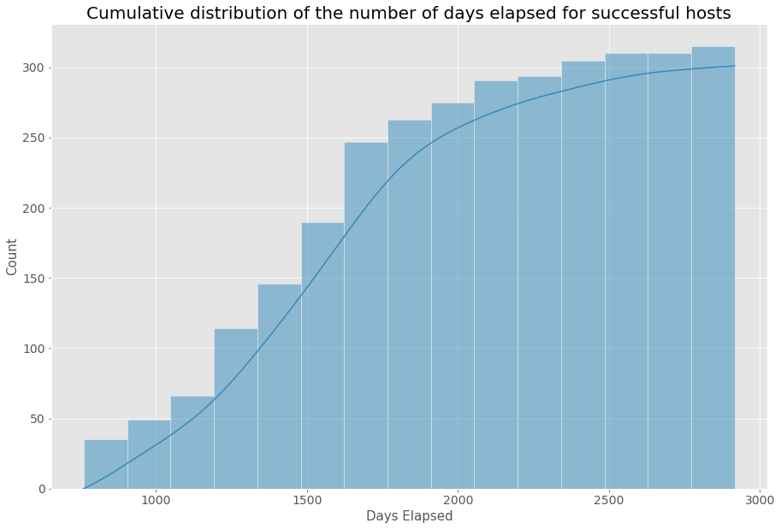
How long will it take for me to be successful? At least 2 years

Slide 24
What to invest in?

Slide 25
Conclusion
Is there any opportunity for investment?
A Boathouse in De Baarsjes - Oud-West is a low hanging fruit as there are only 3 successful hosts in the area.
The average price per bedroom among the hosts about $120.
Or we could invest in a Boathouse at De Pijp – Rivierenbuurt as there doesn’t seem to be any successful Boathouse hosts as of yet.
Caveats:
Could be a high risk venture as there may be underlying reasons as to why there aren’t that many boathouses in the area to begin with.
It takes at least 2 years to be a successful hosts
Other than the price of the property, there are other significant upfront costs investments into furnishing.

